Slide 1
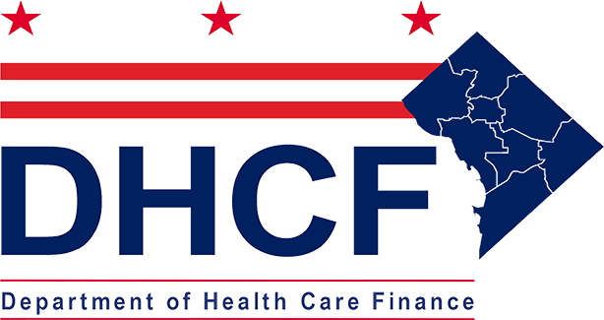
Community Resource Information and Exchange (CoRIE) Initiative
David Poms, DC Primary Care Association
June 2, 2022
Notes:
Welcome to the webinar on the Community Resource Information and Exchange (CoRIE) Initiative.
My name is Sylvia Shirima, and I am the Health Education Manager at the George Washington University Cancer Center.
Let’s begin with few housekeeping items. Please note that all attendees are muted. If you have any questions to the presenter, please use the Q&A feature and NOT chat.

Slide 2
Presenter
David Poms, Partnerships Manager, coordinates the DC PACT initiative, a cross-sector health coalition addressing the social determinants of health, which builds on his experience strengthening the capacity of the emergency food assistance network of the greater Washington, DC area at the Capital Area Food Bank, and his years of experience doing advocacy, outreach and education at City Year Washington, DC and as a Servant-Leader Intern and Youth Advocate Leadership Trainer with the Children’s Defense Fund.
Notes:
Please allow me to introduce you all to today’s speaker.
David Poms, Partnerships Manager, has 10 years of experience working in Washington, DC on social equity programs related to education, food, and health. David currently coordinates the DC PACT initiative, a cross-sector health coalition addressing the social determinants of health, which builds on his experience strengthening the capacity of the emergency food assistance network of the greater Washington, DC area at the Capital Area Food Bank, and his years of experience doing advocacy, outreach and education at City Year Washington, DC and as a Servant-Leader Intern and Youth Advocate Leadership Trainer with the Children’s Defense Fund. David is further developing new DCPCA member capacity building initiatives related to health equity and the structural determinants of health.

Slide 3
DC PACT (Positive Accountable Community Transformation) is a Collective Impact coalition effort of community providers
Problem Statement: Racism and the lack of accountability, alignment and investment has led to inequitable social conditions, health and well-being outcomes
Vision: DC functions as a seamless accountable health community that provides care and the social conditions for racial equity, health equity, and community well-being
Mission: Build the movement to create a seamless accountable health community that achieves equitable individual and community well-being in the District of Columbia through community leadership, policy change, infrastructure development, and care improvement
Notes:
By December 2024, successfully incorporate social risk management into DC Medicaid value-based payment and quality improvement forums
By December 2024, implement DC PACT communication strategies to promote and sustain health system dialogue and action on the social determinants of health
By December 2024, ensure all relevant DC PACT partner organizations use DC HIE-connected solutions for social risk assessment and analytics, resource identification, and care team coordination
By December 2024, leverage citywide well-being assessment to drive health system accountability by using community-defined progress measures on the social determinants of health

Slide 4
Accountable Health Community Model
Notes:
This model will promote clinical-community collaboration through:
Screening of community-dwelling beneficiaries to identify certain unmet health-related social needs;
Referral of community-dwelling beneficiaries to increase awareness of community services;
Provision of navigation services to assist high-risk community-dwelling beneficiaries with accessing community services; and
Encouragement of alignment between clinical and community services to ensure that community services are available and responsive to the needs of community-dwelling beneficiaries.
This is the beginning building block of where we started
Our view is that in order to fully address health related social needs, we’ll need to go beyond this, through the collective impact model
Talk here about community engagement being one of the reasons we decided to move past the AHC model to use the collective impact model

Slide 5
Collective Impact
Solutions and resources are not known in advance, and typically emerge throughout the process.
We cannot predict the solutions at the outset, and that is uncomfortable
Initial focus on creating effective structure for interaction
The process itself is the solution/reveals the solution
THINK: EVOLUTION
Notes:
5-6 months subcommittee cycles for the following:
1. Determine the scope for the present period, grounded in local data, context, assets, needs, and best practices as well as barriers and facilitators for change
2. Design short and long term strategies using the 5 CI strategies as a guide (i.e. Better understanding ,Learning by trial, Increasing coordination, Enhancing Services, Policy change opportunities)
3. With chosen strategies, drive implementation through identifying resources, inspiring change, creating evaluation, communicate to wider community, and identify next steps for WG
Cyclical action team format allows for coalition to get the right people to the table for each phase depending on specifics

Slide 6
The DC PACT origin story
2016: Came together to apply for CMS’s Accountable Health Community pilot project
2017: Commitment to work together without CMS support through Collective Impact Model
2018: Completed a Common Agenda through retreats to define where we are and begin engaging more broadly
2019: Received DHCF Community Resource Inventory and Exchange (CoRIE) planning grant
2020: CoRIE technical development phase commenced, led by CRISP and DCPCA
2021: Updated our Common Agenda again
Notes:
#1: By December 2024, successfully incorporate social risk management into DC Medicaid value-based payment and quality improvement forums
#2: By December 2024, implement DC PACT communication strategies to promote and sustain health system dialogue and action on the social determinants of health
#3: By December 2024, ensure all relevant DC PACT partner staff are using DC HIE-connected solutions for social risk assessment and analytics, resource location, and care team coordination
#4: By December 2024, leverage citywide well-being assessment to drive health system accountability to community-defined progress measures on the social determinants of health
Did not exist before AHC – DCPCA emerged as leader thanks to primary care/FQHC role, experience with matching tech to community needs

Slide 7
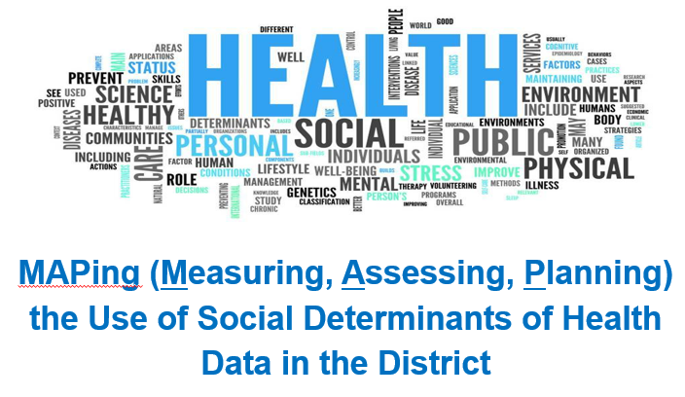
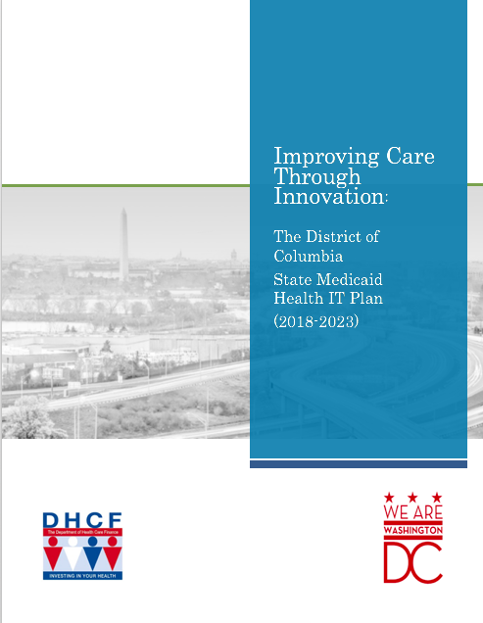
Community Input Led to Focus on Social Determinants of Health
Beginning April 2017, DHCF held a series of discussions on social needs of District residents
2018 District of Columbia State Medicaid Health IT Plan prioritized the collection and use of SDOH data
Explored District efforts to collect and use SDOH data
Generated a set of strategies and tactics to improve health outcomes
Held 80+ person meeting with national experts “level-set” current work and shared priorities
Hosted 20-person workshop on strategies to address collection and use of social need data
Current Landscape of Health IT and HIE
Stakeholder Perspectives and Priorities
5-year Health IT and HIE Roadmap
District health IT and HIE goals
Priority Areas/Use Cases
Supporting Transitions of Care
Social Determinants of Health
Population Health Management
Public Health
Telehealth
Behavioral Health Transformation
2022 SMHP Update released March 2022: https://dhcf.dc.gov/hitroadmap

Slide 8
Collaborated with DC PACT to create an HIE Action Team and conduct a community-wide needs assessment
DC PACT HIE Action Team
DC PACT HIE Action Team was established in 2018 as a multidisciplinary group of District stakeholders (government, health care providers, payers, CBOs) tasked with developing a set of recommended actions to utilize HIE and health IT to move SDOH information.
Conducted small environmental scan of SDOH health IT initiatives across the country – North Coast Health Information and Innovation Network (NCHIIN); NowPow (Chicago); San Diego 2-1-1; and Camden Coalition.
Community resource inventory needs assessment sought to gather technical requirements by engaging 45 District organizations
Led DC Primary Care Association in partnership with Clinovations Gov+Health
Included interviews, questionnaire-based assessments, and focus groups
Community-wide Needs Assessment
Notes:
Findings can offer insight on CoRIE technical solution
HIE Action Team developed and used standardized questionnaire to assess approaches to stakeholder engagement, data and privacy, information exchange across different systems, and specific use cases.

Slide 9
Community-wide needs assessment and findings of the DC HIE Action Team led to a set of recommendations for a technical solution
Easy-to-use
Compatible with provider EHRs
Compatible with existing CBO tools and workflows
Solution should be iteratively built to build consensus
1
General Functions
2
Priority SDOH Domains
Recommended domains for early focus: food, housing, social wellness
Additional domains for review in later phases: transportation, employment/income, public benefit enrollment and eligibility, child development
Phased consensus building domain by domain
3
Enable standardized screening through structured data capture and referrals through multiple interfaces
Focus on “answer set” standardization for capture and exchange instead: Assess opportunities for Z-codes and leverage emerging standards (HL7 Gravity Project)
Screening
4
Referral
Support closed loop referrals with notifications and confirmations to both provider and CBOs
Enable notifications to a patient's care team that alerts providers or case manager to follow-up
Notes:
Technology solution should:
Be easy-to-use
Be compatible with provider EHRs
Be compatible with existing tools and workflows on the CBO side,
Enable screening data capture and referrals through multiple interfaces
Allow closed loop referrals with notifications and confirmations to both provider and CBOs
Enable notifications when patients interact with providers in the system allowing case managers to follow up and check-in
Enable screening and referral information to be shared and displayed regardless of how it was collected
Youth development programs (i.e. Chicago’s MapsCorp) to keep resource inventory up-to-date
FY1Needs and approaches to enhance ability to address health care and social needs
Priorities for the domains used to conduct social determinants of health screening and make referrals
Priorities regarding the features or specialized requirements for the technical platform
Priorities for future state of screen, refer, fulfill, and feedback
Stakeholders provided insight on current SDOH workflows and priority key domains
Ensure care partners can view the same information via DC HIE regardless of the vendor platform they use

Slide 10
Stakeholders considered 3 technical options based on current SDOH workflows and priority key domains
1
BUY
2
BUILD
3
BRIDGE
Involves the purchasing of a third-party solution
Procurement of a solution via this approach assumes the purchase or license of a commercially available product, software-as-a-service, or integrated platform and services approach.
Involves building out current infrastructure.
Assumes custom software development that may consist of a work-for-hire solution that is hosted and maintained within DC HIE or managed by the selected developer.
Expanding current infrastructure capabilities (“Build”) and integrating with other platforms that leverage community investments (“Buy”).
District Stakeholder Recommendation: BRIDGE Option
Build upon current DC HIE capabilities.
Identify and assess gaps in current capabilities that could be addressed via a 3rd party platforms to maximize adoption and use.
Focus on optimizing of existing workflows that enhance community partnerships and achieve buy-in from system leaders through iterative development and quick wins.

Slide 11
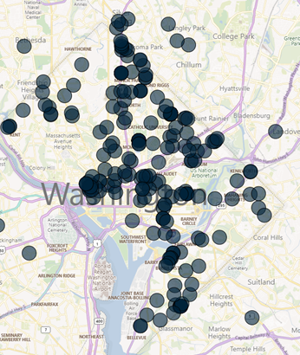
Since 2018 the DC HIE Demonstrated Substantial Progress to Expand the Network of Participating Users
Today Major Providers and Health Systems are Connected
DC HIE Connectivity: DC and beyond the borders of the District
8 Hospitals (all)
36 Long Term Care Facilities, including 15 Nursing Facilities;
20 Home Health Providers
8 Federally Qualified Health Centers (all)
30 Behavioral Health Providers
8 Community Based Organizations
DC HIE Use at a Glance (as of March 2022)
13,000+ approved users of the DC HIE
Patient Care Snapshot (Monthly Query)
1,156 users
Encounter Notification Services access
619 locations
Sharing Admit, discharge, transfer
~300 locations
Sharing Clinical care documentation
200+ locations
is the District of Columbia’s Designated HIE
Notes:
Over 13,000 approved users of the DC HIE (a significant increase of 49% from November 2018).
More than 600 practice sites now have access to admit, discharge and transfer (ADT) alerts via the CRISP DC encounter notification system (ENS). Nearly 300 sites now share ADT information, resulting in a substantial increase in bi-directional exchange compared to 2018.
DC HIE consists of registered and designated HIE, CRISP DC is the District’s designated HIE and DHCF’s prime partner in HIE technical structure.

Slide 12
The DC HIE is a health data utility with 6 reliable core capabilities that include SDOH screening, resource inventory, referral functions
Critical Infrastructure (e.g. Encounters and Alerts) Lookup)
Advanced Analytics for Population Health Management
Directory and Secure Messaging
Screening and Referral (e.g., SDOH)
Consent
Registries
ADT Alerts
eConsent Solution
Care Management Registry
Provider Directory
eReferral Screening
CRISP DC Reporting Services
Health Records
-SUD (42 CFR Part 2) Data Consent
-HIPAA Consent
-Telehealth Consent
Advance Care Planning
Community Resource Inventory
-Social needs screening
-eReferral to community resources and supports
Performance Dashboards
Patient Snapshot
-Advance Directives
-eMOST
Vaccine Tracker
Image Exchange
Notes:
The District and CRISP DC, as the District’s Designated HIE, view the overall system and DC HIE marketplace as a health data utility that can exchange electronic health-related data across the network of care within the governance model described in the previous sections.
The DC HIE, as a health data utility, is a public good enabled through cross-sector partnerships that provides shared services and fosters a culture of shared responsibility for ensuring the availability and quality of actionable information. In this model, the primary value of the tools and resources is the extent to which each can draw data from across the network to support user stories – real world examples – that demonstrate ways health information exchange is essential to high quality, person-centered care.
In the 2018 SMHP, DHCF and the HIE Policy Board developed four use cases – transitions of care for individuals, social determinants of health, population health management, and public health – to guide the design development, and implementation of health IT and HIE. The use cases represent key functions of the District health IT and HIE infrastructure that had stakeholders identified as essential for delivery of care to residents and patients.
The technological building blocks that operationalize the use cases were further developed and implemented as core capabilities for District providers.
Together, these six core capabilities make up the health data utility model, which is highly modular and scalable. The shared service infrastructure implemented by CRISP, with approval from the CRISP DC Board, also creates opportunities for re-use of technology among participating states. For example, Maryland’s adoption of the patient snapshot approach developed by DC.
The DC HIE critical infrastructure tools are currently the most commonly used DC HIE core capabilities. These tools – ADT Alerts, Health Records, Patient Care Snapshot, and Image Exchange – have been available to providers the longest, since 2014 (for ADTs) and 2019. CRISP DC has also made it easier to fully integrate CRISP tools into providers’ EMRs, which is known to greatly improve adoption. Furthermore, health records and image exchange are conceptually familiar to providers – these are essentially electronic versions of documentation traditionally received via fax, but are now delivered through a centralized mechanism, the DC HIE.
Other newly developed tools, such as screening and referrals for social determinants of health and advanced analytics for population health management are in their first or second phases of release and will require changes in clinical workflow. Furthermore, upcoming releases of eConsent and advance care planning will increase patient engagement with DC HIE infrastructure. These four HIE tools are designed to allow beneficiaries, patients, and their caregivers to express their preferences for information sharing and care delivery. It stands to reason that implementing new ways of collecting patient preferences will also require additional education and training to ensure they are most effectively used to promote patient-centered care.
Provider Directory: 31,000 contacts from 251 orgs
Includes data:
-12 national sources
- 20 DC/Local

Slide 13
What is the Community Resource Information Exchange (CoRIE) Initiative?
DHCF, CRISP DC, DC Primary Care Association, and DC Hospital Association are collectively known as ‘CoRIE Partners’
Committed to supporting and sustaining technical solutions and enabling coordinated whole person care across health, human, and social service providers in the District.
CoRIE is a Partnership
Screening for social risks and share dispositions
Lookup resources through a centralized community inventory (CRI)
Refer to appropriate community and support services
Together these 3 functionalities enable data sharing among health system stakeholders to address individuals’ social needs.
CoRIE is a set of 3 technical functionalities to address SDOH
Enables screening and referral information to be shared and displayed regardless of how it was collected
Ensures care partners can view the same information via DC HIE regardless of the vendor platform they use
CoRIE is a Vendor Agnostic Approach
Digitally connects care partner, including health and social service providers, through the DC HIE health data utility
Provides shared services across the region
Fosters a culture of shared responsibility for ensuring the availability and quality of actionable information
CoRIE is an Interoperable System within the DC HIE

Slide 14
District stakeholder continue to be actively engaged in informing the development and implementation of the CoRIE Initiative components
Over 100 representatives from healthcare systems, managed care organizations, government agencies, coalitions/multi-stakeholder groups, community-based organizations are actively engaged in informing the development of the CoRIE Project components.
CBO Design Group (informing the general design of the referral platform and CBO analytics)
Community Resource Inventory (CRI) Action Team (developing and testing CRI)
Standardization Action Team (standardizing screening and referral information)
DC HIE Policy Board CRI Subcommittee (developing governance standards)
Active in national SDOH standardization effort led by the Gravity Project.
Discussions underway with key stakeholders to agree upon a minimum set of common screeners for housing, nutrition, and behavioral health, which can be implemented within CoRIE infrastructure in FY22.
Promote CoRIE technologies among stakeholders and the broader community of users
Support population-level screening via care coordination programs, etc.
Promote or require eReferral
Notes:
Over 100 participants, because there are 70 orgs in DCPACT (per David), and we have talked to at least 72 unique orgs in the engagement spreadsheet, with usually more than 1 person per org.

Slide 15
DC’s 2022 SMHP Update prioritizes continued engagement CBOs and partnership with clinical providers to expand access and use of social needs information HIE
Access and exchange of social needs information – particularly housing and nutrition – through the HIE supports whole person care.
Develop refinements to the HIE functionality that promote access and engagement in the DC HIE among CBOs / social service agencies.
Explore what new use cases would be most beneficial for CBOs, the provider network, and Medicaid beneficiaries to integrate social needs data, drive their interest, and maximize value.
Diversify Boards and Committees across various governance structures to ensure that the full breadth of partners – particularly those that are representing new and emerging use cases – including CBOs and other less-well represented groups, including behavioral health and long-term care.
Fund pilot projects to test use cases and specific value-added collaborations between clinical providers and non-clinical CBOs/social services agencies.
Notes:
Over 100 participants, because there are 70 orgs in DCPACT (per David), and we have talked to at least 72 unique orgs in the engagement spreadsheet, with usually more than 1 person per org.
On-board District Social Service Providers to the platform to facilitate the exchange of SDOH information that improves coordination and the delivery of whole person care.
Future links with DCAS and other systems
Leverage CoRIE capabilities to inform and refine Medicaid innovations, reforms, interventions to address social needs and improve health equity.

Slide 16
What does success look like for DC PACT?
Build capacity for organizational and system change
Build shared measurement consensus for strategic goals through action teams
Provide a strong collective framework that engages the health, social and public sectors in moving toward a seamless accountable health community that increases health equity in the District of Columbia

Slide 17
Appendix

Slide 18
CoRIE is designed to enable social needs screening and referral through DC HIE infrastructure without requiring a single District-wide platform
Choose 1 of 4 pathways to capture and share SDOH screening and referrals
Each pathway contributes data to the DC HIE
DC HIE Users can view screening and referrals from each pathway in the social needs tab
1
Use 3rd Party SDOH Network Platforms
Vendor integration with CRISP enables transmission of screening and referral data
Social Needs Tab
Providers, MCOs, and health system stakeholders use different systems to:
Collect social needs information from patients
Make referrals to community services
CoRIE allows 4 pathways to capture and share SDOH screening and referral data with care partners through the DC HIE
CSV files containing referral data
2
Use an EHR
CSV files containing screening data elements
DC HIE users can view referral history made in non-DC HIE systems
DC HIE users can view conditions based on extracted z-codes
Z-codes extracted from CCDs reflecting screening dispositions
3
Use Direct-entry Screening Tool to capture SDOH screening/assessment
DC HIE users can view assessments captured via the CRISP DC Screening Tool or third-party platform
Screening and assessment data elements
4
CBOs can
Receive referrals for services
Communicate with referring provider
Close the loop
Use Referral Tool to send referral to CBO
Referral Tool
Notes:
Providers, MCOs, CBOs, and others using the same 3rd party platform can continue sending/receiving referrals through AB, etc.

Slide 19
The DC CRI requires community participation to ensure records for programs and services offered are up-to-date
Community program and service info from disparate sources is fed to various regional data stewards
Designated stewards assume responsibility for info from each source in their domain (“Registers”)
Each individual resource inventory seamlessly contributes information to the DC CRI while retrieving information on programs outside of their domains according to the standards and governance set to support a cooperative network by the DC HIE Policy Board CRI Subcommittee
DC CRI is a component of the DC HIE health data utility – it is (for now) managed by the CoRIE project partners
There are 3 ways to publicly access the same information about community programs and resources in the DC CRI
1
2
3
4
5
Eldercare & other service providers
DC Government Agencies (e.g. DACL, CFSA)
Share updated resource data about services within their specific domain via API connection
Resource lookups via the DC CRI website (prototype): http://dc.openreferral.org
DC Community Resource Inventory (CRI)
Food pantries & programs in DMV-area
Capital Area Food Bank
Resource lookups via the CRISP DC Portal
DC-PACT member organization programs
DCPCA
Receive updated resource information about other services outside their domain via API connection
DC-proximate services in MD
Maryland 2-1-1
via API to the DC CRI from your system
Quality Assurance
Other human and social services & programs
Other prospective resource inventory data stewards
Notes:
Where does the maintenance of the data/information occur? How do changes/edits get resolve?
Is the CRI a place to make resource data available, create entries?
Overlapping resources in inventories – which one will take precedence? Does the DC CRI maintenance steward decide based on the standards established by the CRI subcommittee?

